Slide 1
JavaScript by Example
COMP 3700

Slide 2
JavaScript Objects
You'll hear more about these on Friday, but the following will be helpful going into that
It is useful to think of every object as a
Dictionary<string, object>
You can access object components by key using either instance variable or index notation
.prop or ["prop"]
A method is also a function in the dictionary
and functions are also objects

Slide 3
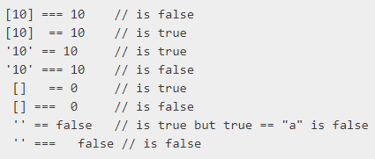
JavaScript Tips & Tricks
Don't forget to declare variables using var
When in doubt, use === instead of ==
Even though semicolons are optional, use them!
The first line of every js file should be:
'use strict';

Slide 4
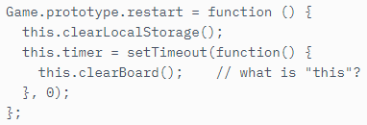
JavaScript Warnings
JavaScript does not have block-level scope
this is not always this
context is important, but not always easy to figure out
for in construct can give surprising results

Slide 5
Cool JavaScript Applications
Calculator
Tearable Cloth
3D Solar System
Fractal Zoom
Pool of Balls

Slide 6
More Learning Resources
Code Academy JavaScript tracks: http://www.codecademy.com/tracks/javascript
Eloquent JavaScript by Marjin Haverbeke: http://eloquentjavascript.net/
Advanced JavaScript by John Resig: http://ejohn.org/apps/learn/

